Slide 1
Physical Chemistry
Ying Hu
(Fifth edition)
Bilingual Program
版权所有：华东理工大学物理化学教研室

Slide 2
Part V Extension
Chapter 17
Electrochemistry
Bilingual Program
版权所有：华东理工大学物理化学教研室

Slide 3
16. Electrolyte Solutions
I. Electrochemical Equilibria
    17.2 Electromotive Force of Galvanic Cell and Interfacial Potential Difference
    17.3 Thermodynamics of Electrochemical Systems
    17.4 Potential and Standard Potential of Cell Reaction
    17.5 Potential and Standard Potential of Electrode Reaction
    17.6 Various Types of Electrodes and Standard Cell
    17.7 Electrochemical-Equilibrium Calculations
    17.8 Concentration Cell and Liquid-Junction Potential

Slide 4
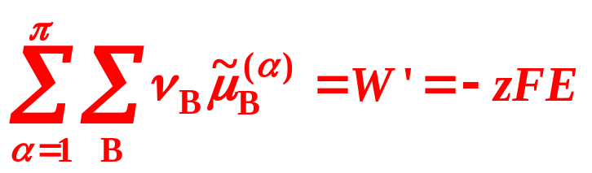


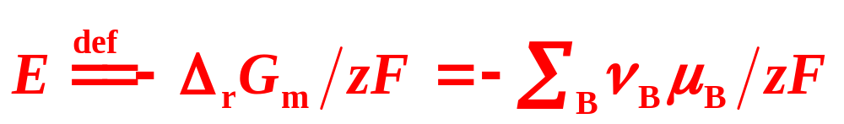
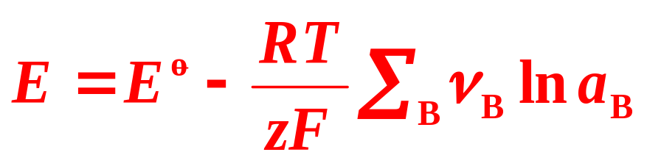
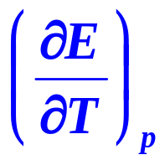
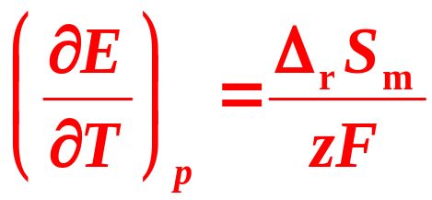
17.4 Potential and Standard Potential of Cell Reaction
Electrochemical Equilibrium Criterion
Potential of Cell Reaction
Nernst Equation
Temperature Dependence of Potential of Cell Reaction

Slide 5

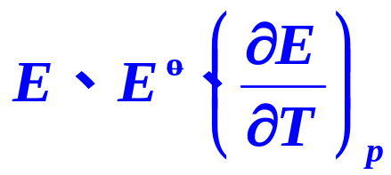
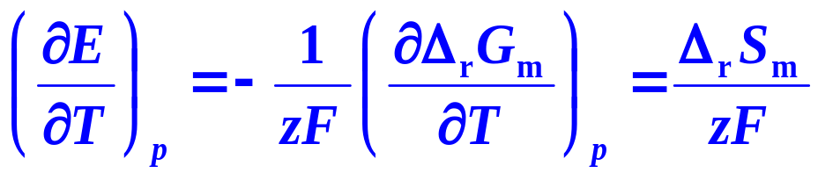

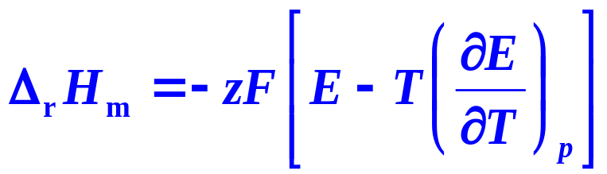
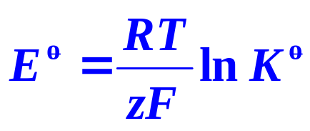
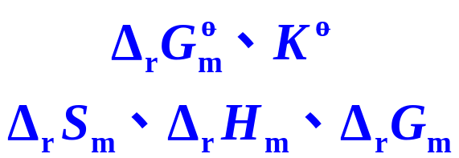
17.4 Potential and Standard Potential of Cell Reaction
Experimental Determination
Calculation

Slide 6
16. Electrolyte Solutions
I. Electrochemical Equilibria
    17.2 Electromotive Force of Galvanic Cell and Interfacial
    Potential Difference
    17.3 Thermodynamics of Electrochemical Systems
    17.4 Potential and Standard Potential of Cell Reaction
    17.5 Potential and Standard Potential of Electrode Reaction
    17.6 Various Types of Electrodes and Standard Cell
    17.7 Electrochemical-Equilibrium Calculations
    17.8 Concentration Cell and Liquid-Junction Potential

Slide 7
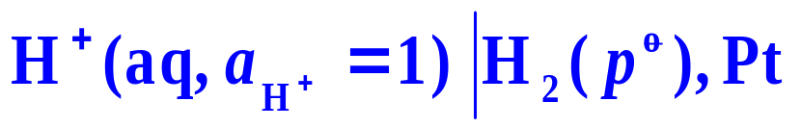
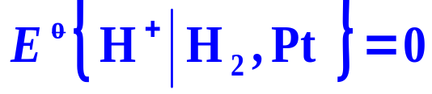

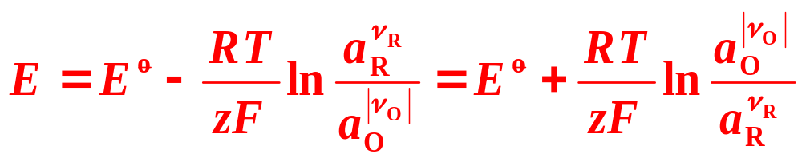
17.5 Potential and Standard Potential of Electrode Reaction
Standard Hydrogen Electrode (SHE)
Standard Potential of Electrode Reaction
Nernst Equation for Electrode Reaction

Slide 8
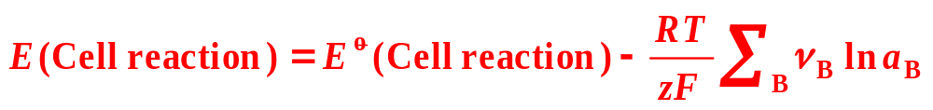
17.5 Potential and Standard Potential of Electrode Reaction
5. Relation between Potential of Cell Reaction and Potentials of Electrode Reaction
Nernst Equation

Slide 9
16. Electrolyte Solutions
I. Electrochemical Equilibria
    17.2 Electromotive Force of Galvanic Cell and Interfacial
    Potential Difference
    17.3 Thermodynamics of Electrochemical Systems
    17.4 Potential and Standard Potential of Cell Reaction
    17.5 Potential and Standard Potential of Electrode Reaction
    17.6 Various Types of Electrodes and Standard Cell
    17.7 Electrochemical-Equilibrium Calculations
    17.8 Concentration Cell and Liquid-Junction Potential

Slide 10
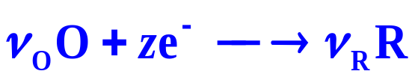
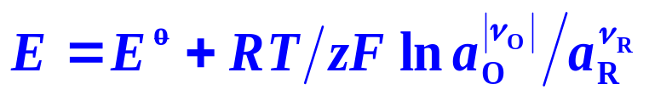
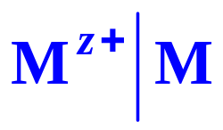
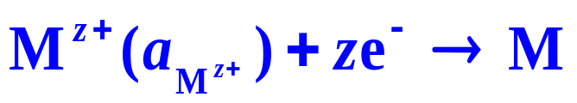
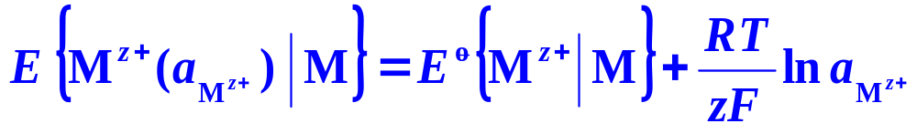
17.6 Various Types of Electrodes and Standard Cell
Electrode： Solution│Electrode
Electrode reaction：
Nernst Equation:
1. Metal-Metal Ion Electrodes

Slide 11
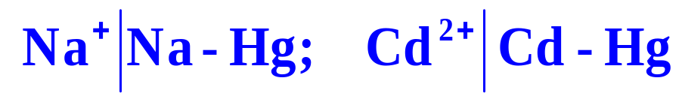
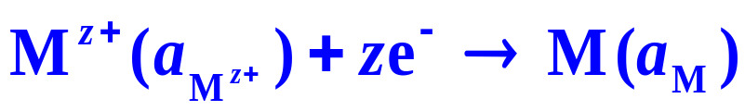
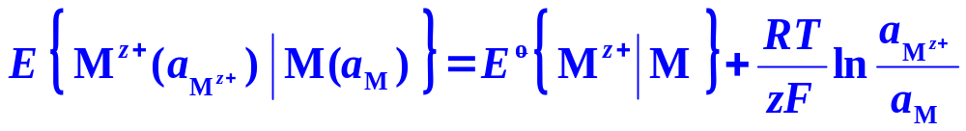



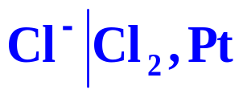
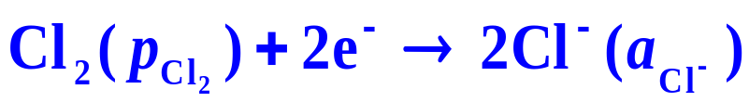
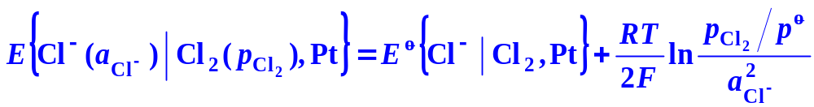
17.6 Various Types of Electrodes and Standard Cell
2. Metal Amalgam-Metal Ion Electrodes
3. Platinum-Nonmetal-Nonmetal Ion Electrodes

Slide 12
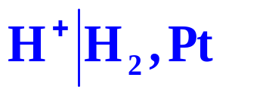
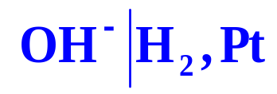





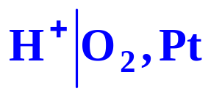

17.6 Various Types of Electrodes and Standard Cell
3. Platinum-Nonmetal-Nonmetal Ion Electrodes
Different Forms of Expression for Hydrogen Electrode and Oxygen Electrode
Hydrogen Electrode
 | Acidic solution | Basic solution
Electrode
Electrode reaction
Oxygen Electrode
Electrode

Slide 13
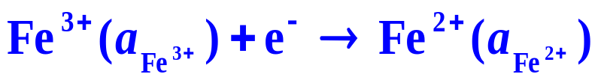
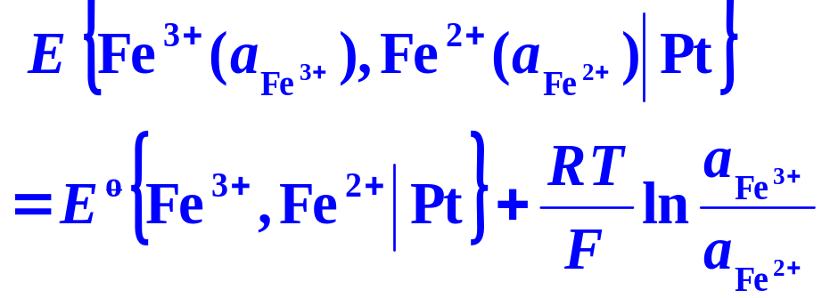
17.6 Various Types of Electrodes and Standard Cell
4. Oxidation-Reduction Electrodes
Example
Electrode
Electrode reaction
Nernst Equation:

Slide 14
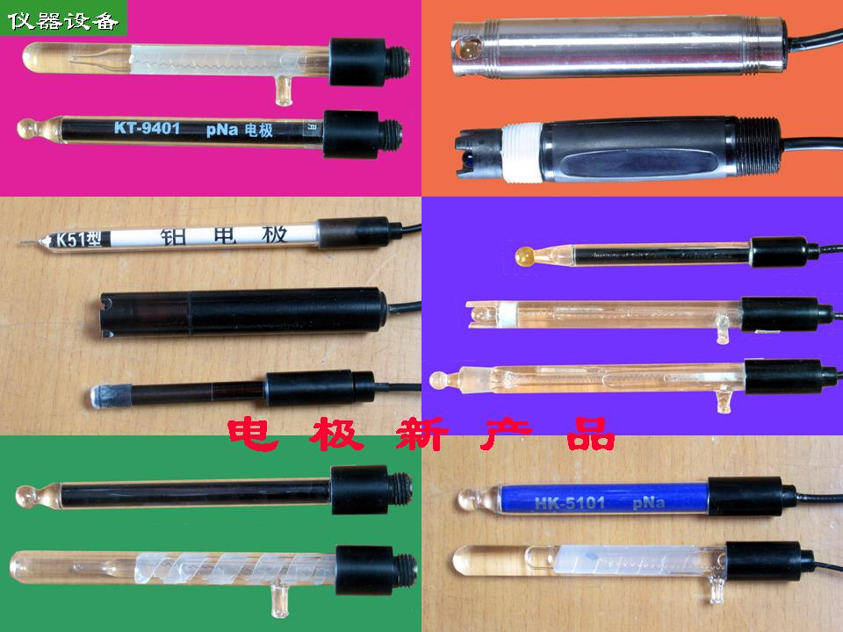
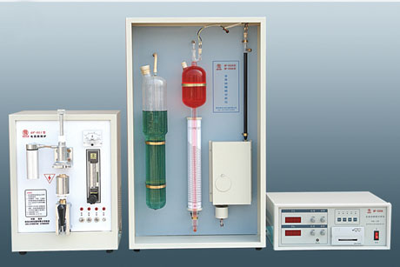
17.6 Various Types of Electrodes and Standard Cell
5. Metal-Sparingly Soluble Salt-Anion of the Salt Electrodes
Example
Electrode
There are three phases in the electrode, the electrode reaction proceeds on the two solid-liquid interfaces.

Slide 15
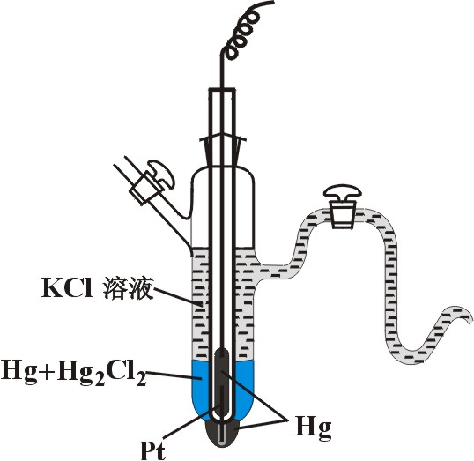
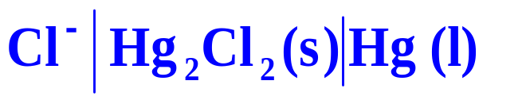
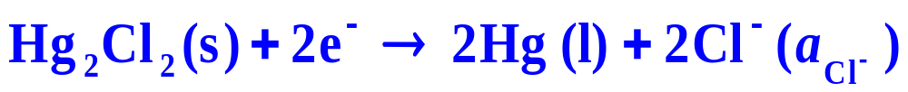
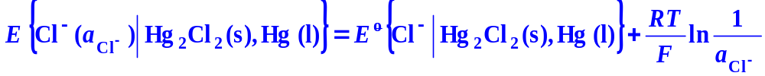
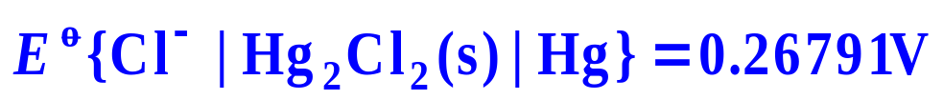
17.6 Various Types of Electrodes and Standard Cell
5. Metal-Sparingly Soluble Salt-Anion of the Salt Electrodes
Calomel Electrode
Electrode
Electrode reaction
Nernst Equation:
With the saturated KCl, the standard potential of electrode reaction of the calomel electrode at 25°C is:

Slide 16
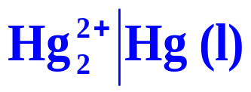
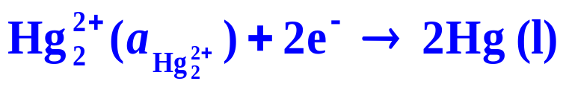
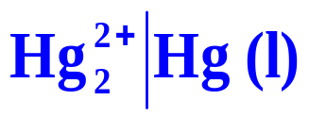
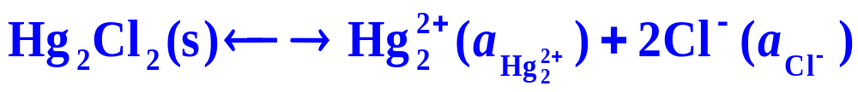

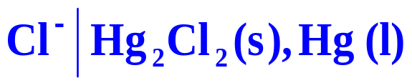
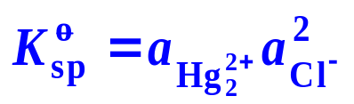
17.6 Various Types of Electrodes and Standard Cell
5. Metal-Sparingly Soluble Salt-Anion of the Salt Electrodes
Calomel Electrode
Also can be expressed as
They have the same potential of electrode reaction, but the standard potentials of the two forms are different. The difference can be obtained by using the solubility product of calomel,

Slide 17
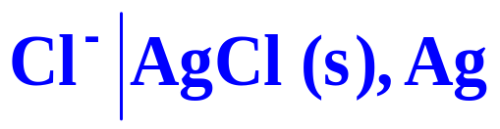
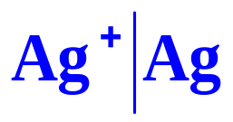
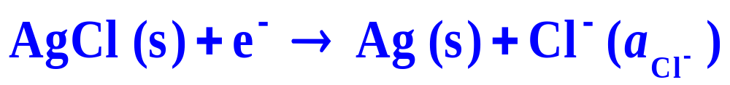
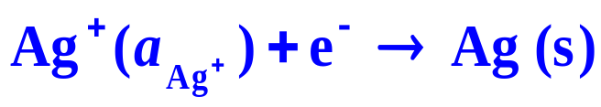

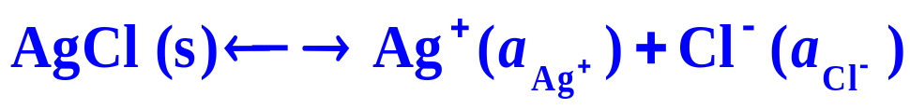

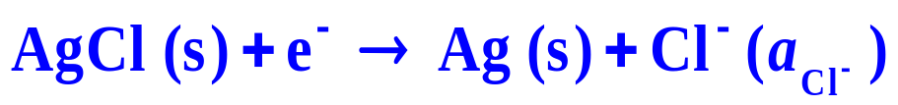
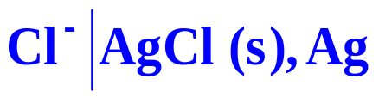

17.6 Various Types of Electrodes and Standard Cell
5. Metal-Sparingly Soluble Salt-Anion of the Salt Electrodes
Silver Chloride Electrode
or
The standard potentials of electrode reaction
is 0.22216V at 25°C

Slide 18



17.6 Various Types of Electrodes and Standard Cell
6. Ion-Selective Electrodes
The electrode potential of ion-selective electrodes is a membrane potential originated from the ion-exchange equilibrium on the electrode membrane.
Glass Electrode
A membrane potential is created due to the H⁺ ion exchange on the interface. A concentration potential is formed between the two sides of the glass membrane.
The contributions of the solution sealed, the inner reference electrode and the diffusion inside the membrane are all accounted in

Slide 19



17.6 Various Types of Electrodes and Standard Cell
6. Ion-Selective Electrodes
Solid Membrane Electrodes
These electrodes are constructed by solid membrane connecting with the lead. The membrane is made of ionic crystal which is able to conduct electricity.

Slide 20








17.6 Various Types of Electrodes and Standard Cell
6. Ion-Selective Electrodes
Ion Exchange Membrane Electrodes
PVC or silicon rubber is usually used as a carrier with the solvent and chelating agent contained to form an ion exchange membrane.

Slide 21





17.6 Various Types of Electrodes and Standard Cell
7. Standard Cell
Weston cell, E = 1.018646V at 293K,
The standard cell is used for calibration in determinations
Negative electrode
Positive electrode
Cell reaction

Slide 22
16. Electrolyte Solutions
I. Electrochemical Equilibria
    17.2 Electromotive Force of Galvanic Cell and Interfacial
    Potential Difference
    17.3 Thermodynamics of Electrochemical Systems
    17.4 Potential and Standard Potential of Cell Reaction
    17.5 Potential and Standard Potential of Electrode Reaction
    17.6 Various Types of Electrodes and Standard Cell
    17.7 Electrochemical-Equilibrium Calculations
    17.8 Concentration Cell and Liquid-Junction Potential

Slide 23









17.7 Electrochemical-Equilibrium Calculations
1. Basic Calculations for Potentials of Cell Reaction and Potentials of Electrode Reaction
Calculate the standard potential of cell reaction at 25°C for the cell and write the corresponding cell reaction. Calculate the potential of cell reaction at 25°C if and .
Solution
Anode (negative) electrode
Cathode (positive) electrode
Cell reaction

Slide 24



17.7 Electrochemical-Equilibrium Calculations
1. Basic Calculations for Potentials of Cell Reaction and Potentials of Electrode Reaction
Solution
When

Slide 25



17.7 Electrochemical-Equilibrium Calculations
Calculate the potential of the cell reaction and

Slide 26







17.7 Electrochemical-Equilibrium Calculations
Solution 1
Negative
Positive
Cell reaction
~Fuel cell

Slide 27





17.7 Electrochemical-Equilibrium Calculations
Solution 2
Negative
Positive
Cell reaction
Intensive
Extensive

Slide 28






17.7 Electrochemical-Equilibrium Calculations
Solution 3
Negative
Positive
Cell reaction

Slide 29








17.7 Electrochemical-Equilibrium Calculations
K_{w},
So

Slide 30




17.7 Electrochemical-Equilibrium Calculations
From the data of the standard potential of electrodes of,
Calculate the standard potential of electrode
Solution
According to the definition of the standard potential of electrode reaction, we construct the following cell
And the corresponding cell reactions are

Slide 31






17.7 Electrochemical-Equilibrium Calculations

Slide 32







17.7 Electrochemical-Equilibrium Calculations
2. Calculations of Thermodynamic Functions and Standard Equilibrium Constant of Chemical Reactions
Judge the direction of the reaction

Slide 33






17.7 Electrochemical-Equilibrium Calculations
3. Calculations of Ionic Product of Water, Solubility Product of Sparingly Soluble Salts and Instability Constant of Complex Ions
K_{sp} of AgCl
If Ag⁺ and Cl⁻ are in the same bulk solution,
K _{sp} can not be calculated directly
Electrochemical method
Design a cell reaction as
Negative
Positive
Cell reaction
is the same as (1)

Slide 34








17.7 Electrochemical-Equilibrium Calculations
Solution:
At equilibrium

Slide 35


17.7 Electrochemical-Equilibrium Calculations
4. Calculations of Mean Ionic Activity Factors
1. Calculate the mean ionic activity factors of HCl solutions with different concentrations.
Solution:
Design a cell
Determining E, γ± at various concentrations b can be calculated.

Slide 36
16. Electrolyte Solutions
I. Electrochemical Equilibria
    17.2 Electromotive Force of Galvanic Cell and Interfacial
    Potential Difference
    17.3 Thermodynamics of Electrochemical Systems
    17.4 Potential and Standard Potential of Cell Reaction
    17.5 Potential and Standard Potential of Electrode Reaction
    17.6 Various Types of Electrodes and Standard Cell
    17.7 Electrochemical-Equilibrium Calculations
    17.8 Concentration Cell and Liquid-Junction Potential

Slide 37


17.8 Concentration Cell and Liquid-Junction Potential
Concentration Cells
Their cell reaction is a transfer of substance from a higher concentration region to a lower one. Here the cell reaction is not a redox reaction. The total changes in the cell are physical changes
Different electrolytes
Different concentrations
Non-equilibrium
Equilibrium

Slide 38






    17.8 Concentration Cell and Liquid-Junction Potential
2. Solution Concentration Cells
-）Ag │AgNO₃[(a₊)₁] AgNO₃[(a₊)₂] │Ag (+ (a₊)₁< (a₊)₂
Positive
Negative
Cell reaction

